Slide 1
TalkCoffee
January 17, 2024
Edward Halim & Henry Benso
Notes:
Who are you:
Henry Benso, Edward Halim
Who are you presenting to:
Investors, customers passionate about coffee who are willing to pay a premium for coffee

Slide 2
Project Description
A website for users to explore a variety list of craft coffee shops around you and globally
target audience: craft coffee lovers / enthusiasts
Saves time and better results than querying another platform(ex. Google or Yelp)
Notes:
Saves time by only showing craft coffee shops in your queries as opposed to all places such as on Google maps.

Slide 3
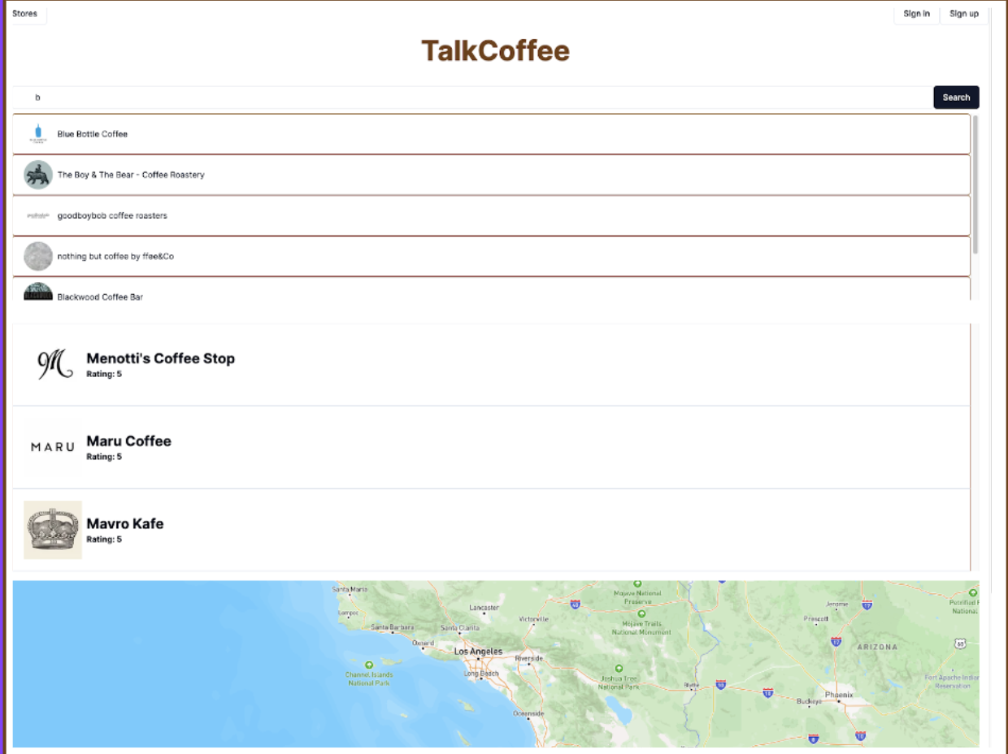
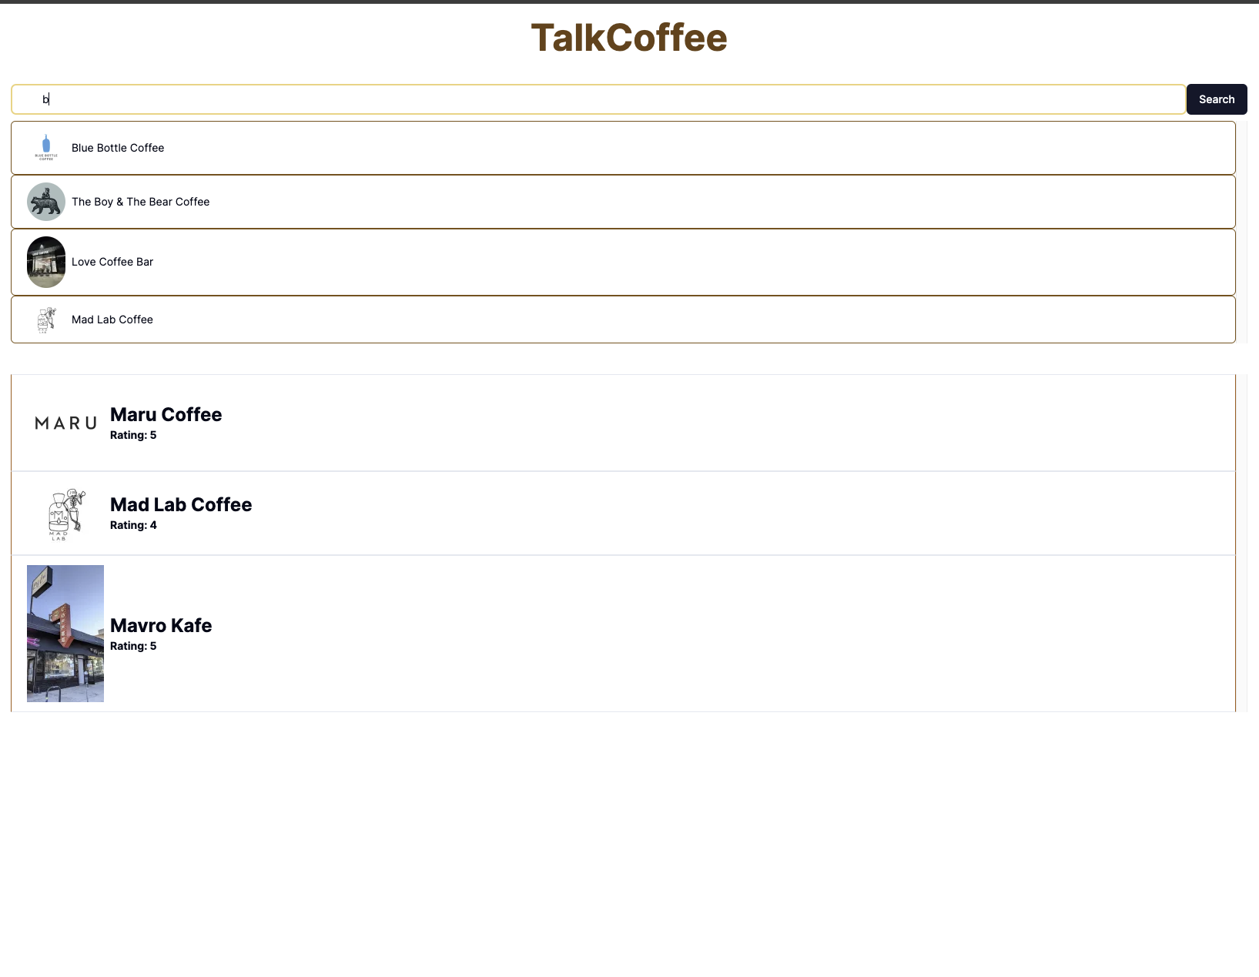
User’s point of view

Slide 4
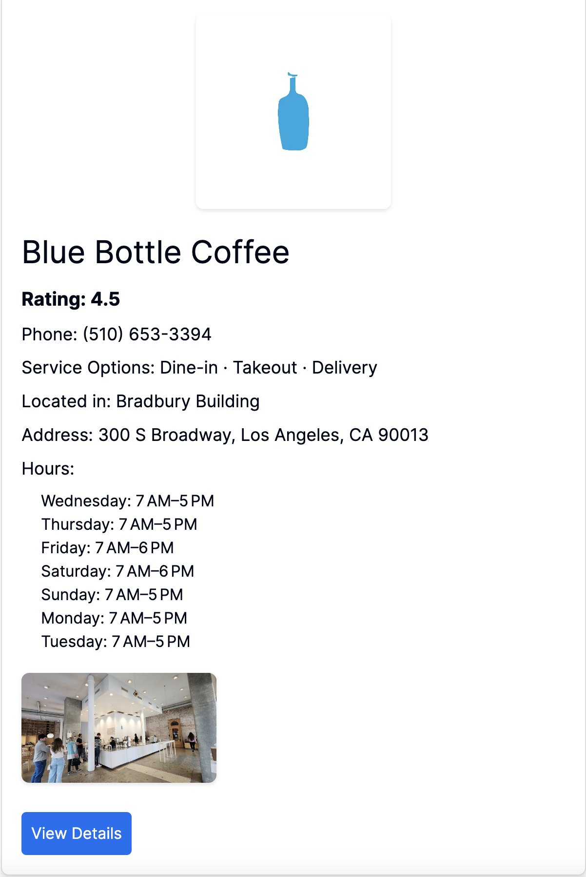
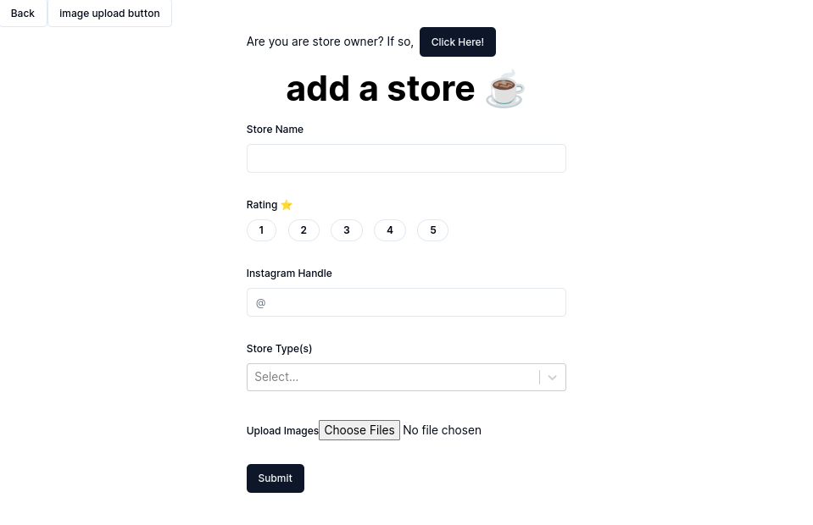
User’s point of view

Slide 5
Why?
Passion for coffee
No platform that caters towards craft coffee lovers
Supporting local businesses
Platform where craft coffee lovers can interact with one another
aggregating a large centralized dataset of information about coffee
full-stack app with many parts to it
Notes:
So why did we choose this project?
Well, we have a passion for coffee that tastes good and gives an adrenaline rush when we need it or not.
Even though there are many distinguished coffee lovers, we found that there is no source people can go to that is catered specifically toward craft coffee shops.
Given our tailored data, we will be able to highlight and support smaller local businesses, given their coffee is amazing, which is a plus to us, all coffee lovers. In addition, smaller store owners will be able to get their store out there on our site by entering their store in by themselves.
We also found there isn’t really a place to converse about coffee with other coffee lovers, so given we implement a sort of chat/forum feature per shop, we plan to bring that interactivity amongst users.
-aggregating a large centralized dataset of information about coffee from all over the world

Slide 6
Questions?

